Slide 1


JSS MAHAVIDYAPEETHA
JSS SCIENCE AND TECHNOLOGY UNIVERSITY
Sri Jayachamarajendra College of Engineering
DEPARTMENT OF ELECTRONICS AND INSTRUMENTATION
TRANSDUCERS AND INSTRUMENTATION-02
(22EI450)
Event-II WIND SPEED CHECKER USING ARDUINO AND ANEMOMETER
Submitted by
Adarsh H N ( USN:02JST22UEI004)
Manoj Kumar M ( USN:02JST22UEI027)
Manoj Maharshi ( USN:02JST22UEI028)
Submitted to:
Ms Rajeshwari P

Slide 2
TABLE OF CONTENTS:
INTRODUCTION.
2. COMPONENTS REQUIRED
3. ANEMOMETER
-WORKING PRINCIPLE.
4. LAYOUT DIAGRAM.
5. METHODOLOGY.
6. CODE.
7. RESULT.

Slide 3
INTRODUCTION
Creating a wind speed checker using an Arduino and an anemometer involves integrating a sensor that measures wind speed with a microcontroller to process and display the data. The anemometer, typically a cup or vane type, generates pulses proportional to the wind speed. These pulses are read by the Arduino, which is programmed to convert them into a wind speed measurement. By connecting the anemometer to the Arduino's digital input pins and writing a simple program, you can accurately measure and monitor wind speed. The Arduino can then output the wind speed data to an LCD display or a computer, providing real-time monitoring. This project combines basic principles of electronics and programming, making it an excellent introduction to sensor integration and environmental data collection.

Slide 4
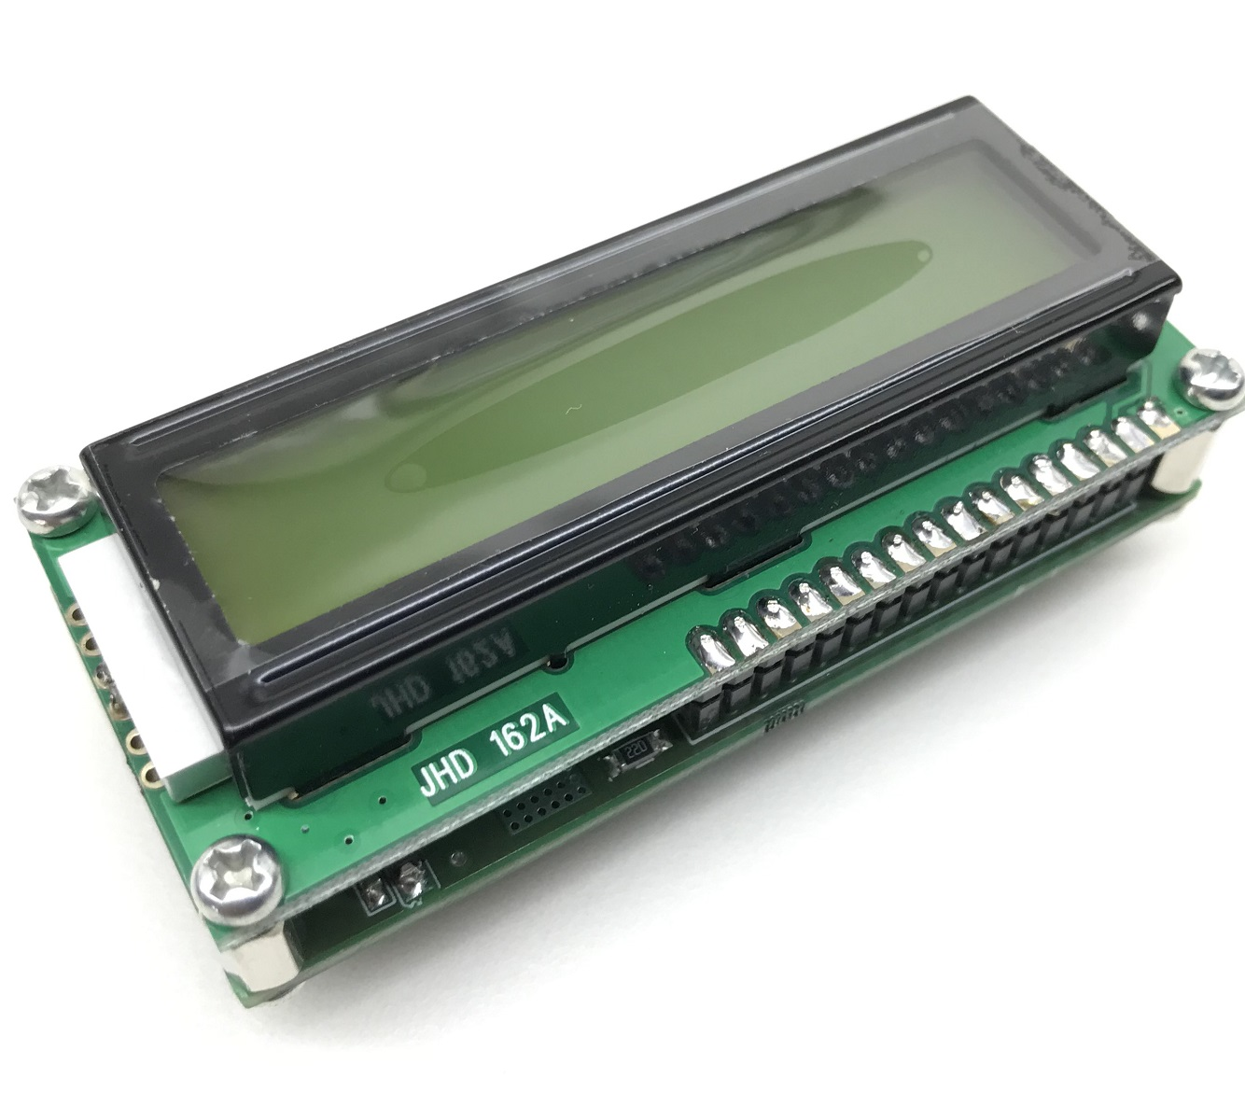
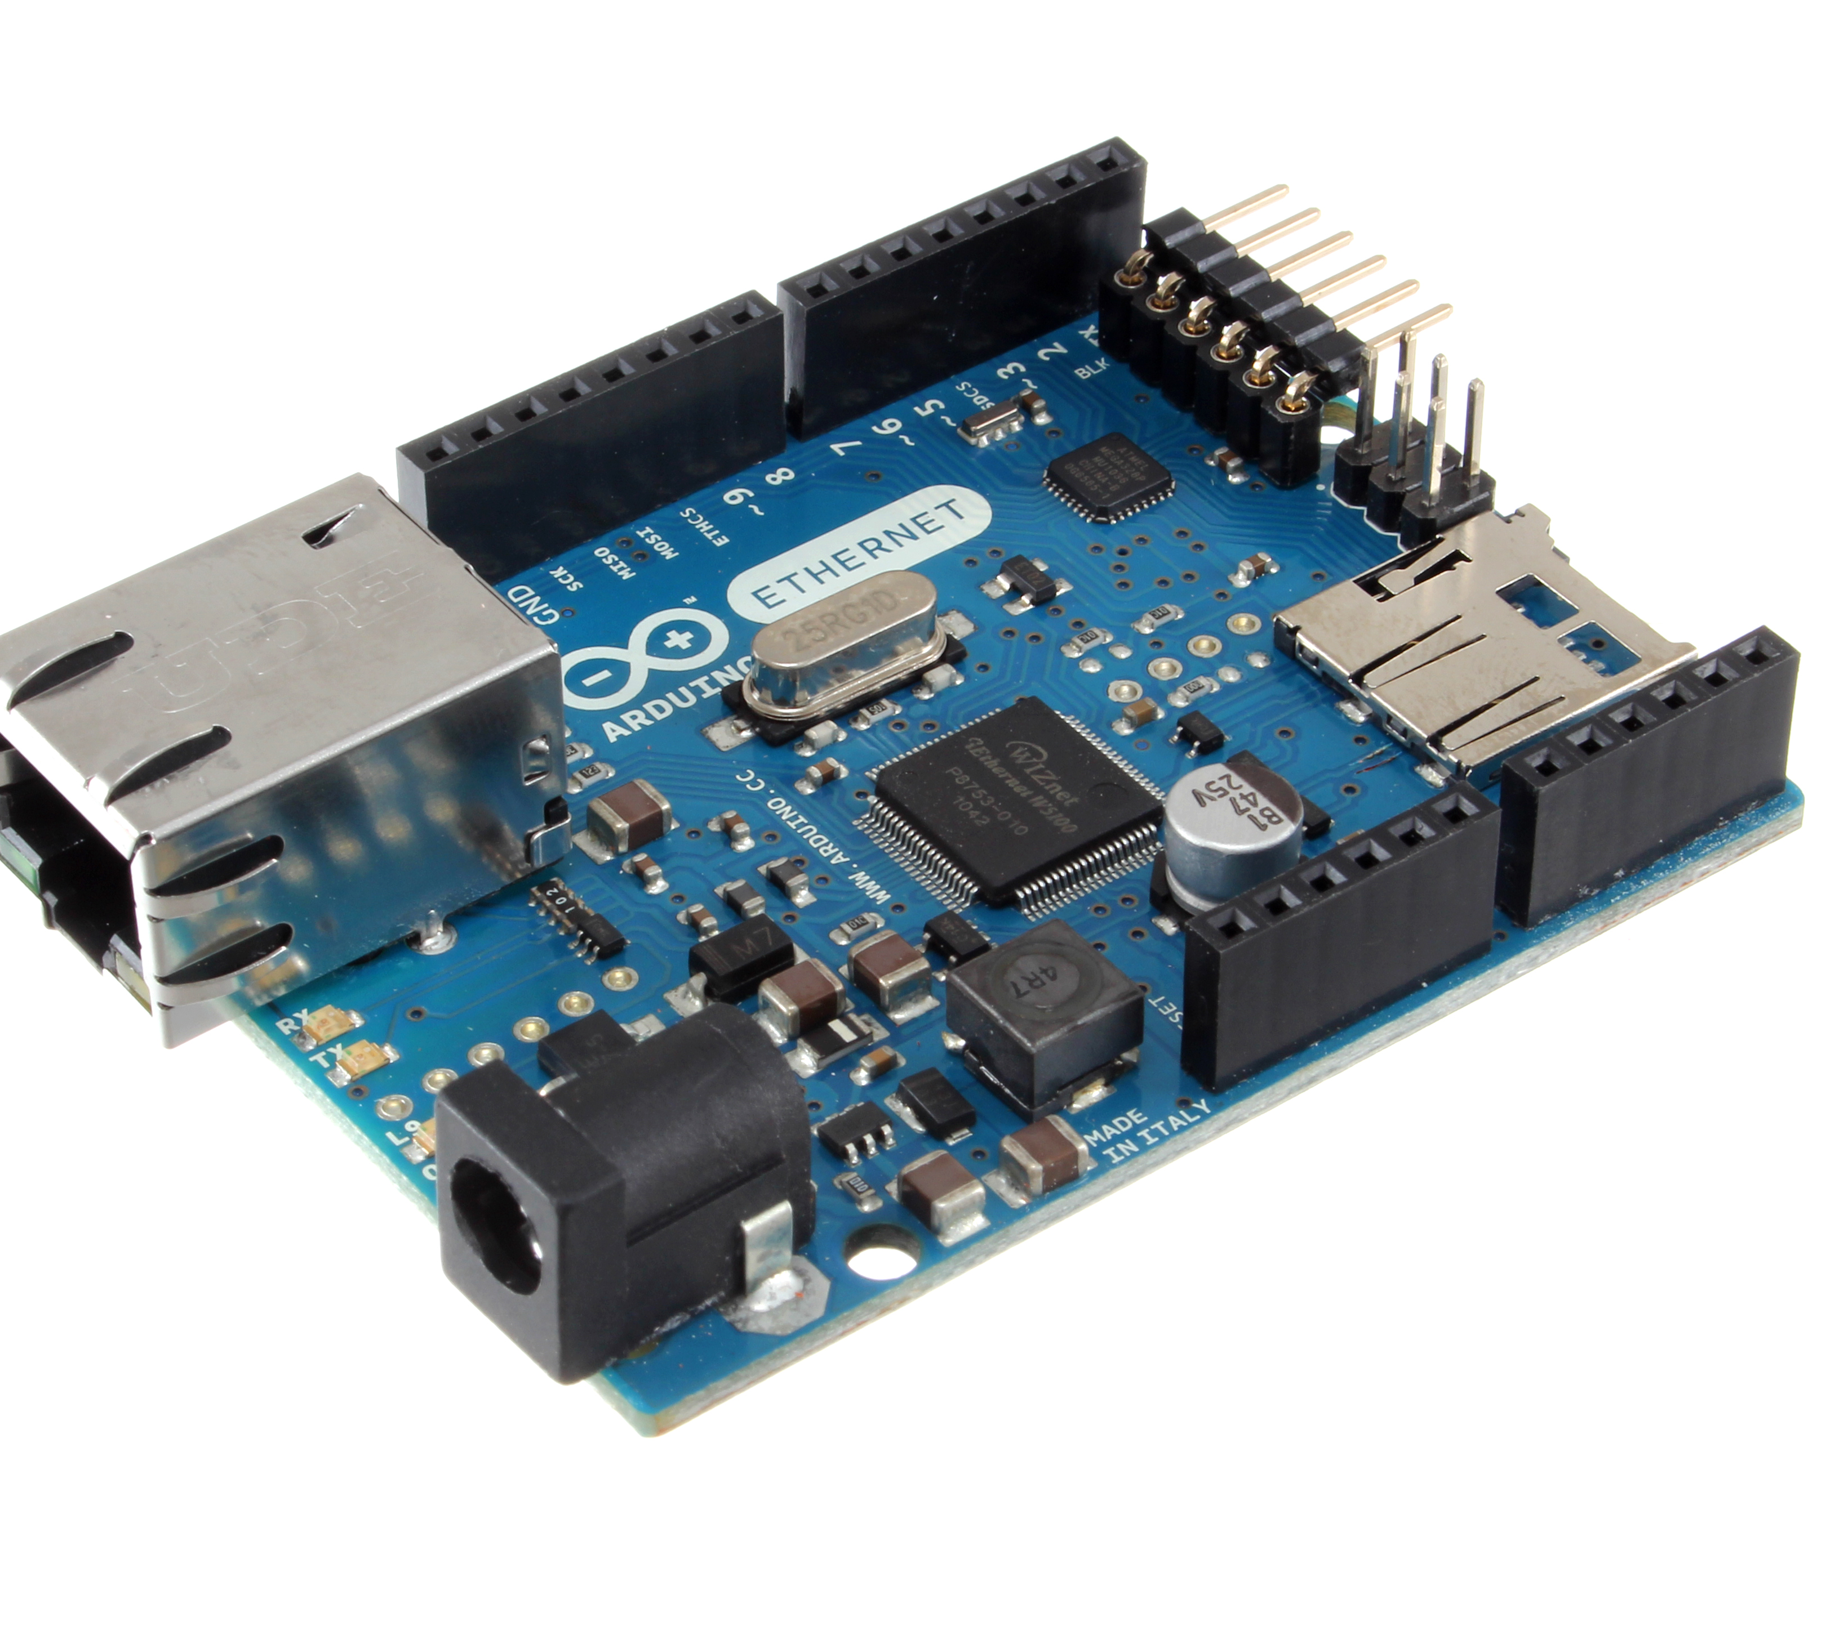
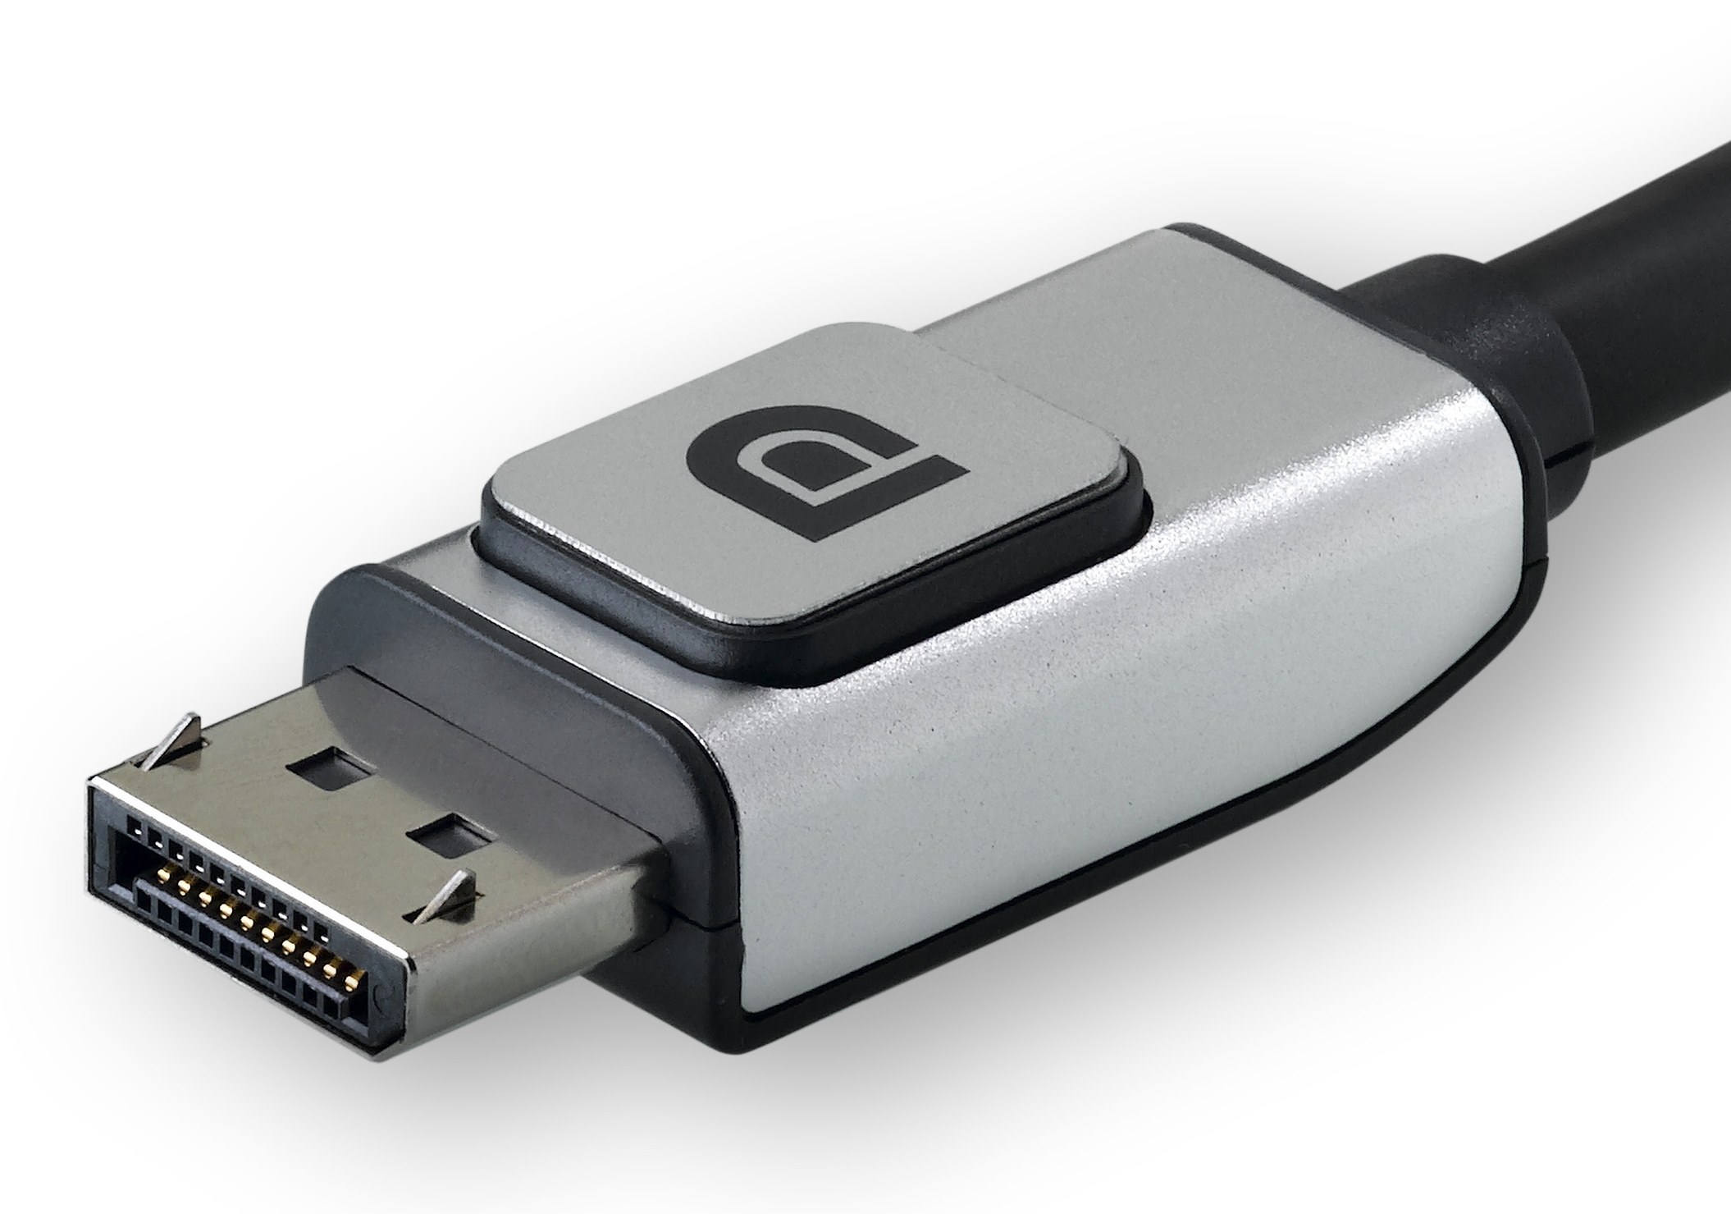
Components required
Anemometer
Arduino
LCD Display
Wind Speed Measurement
Processing and Calculation
Display output

Slide 5
Anemometer
Definition : An anemometer is a device used for measuring wind speed and direction
Component : sensing element, transducer,display\recording device
measurement of an anemometer : it involves the process of determining the wind speed and, in some cases, the wind direction.
Conversion : Converting the measurements from an anemometer depends on the type of data you have and the unit you want to convert to. Anemometers typically measure wind speed, and the common units for wind speed include meters per second (m/s), kilometers per hour (km/h), miles per hour (mph), and knots (nautical miles per hour).
Calbiration : Calibrating an anemometer is crucial to ensure accurate wind speed measurements.
Applications : Blood Glucose Monitors, Air Quality Monitors , Signal Generators and Oscilloscopes, Gas Flow Meters

Slide 6

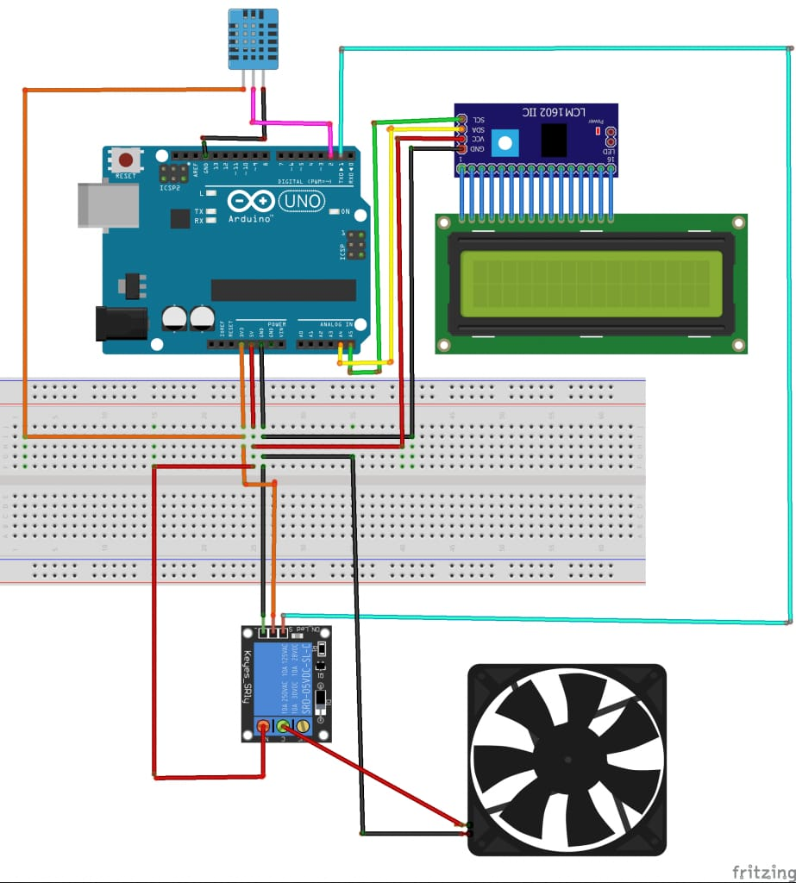



LAYOUT DIAGRAM

Slide 7
METHODOLOGY
A).Gather Components:
Arduino board (e.g., Arduino Uno)
Anemometer (analog or digital output)
Display module (optional, e.g., LCD or OLED)
Connecting wires and breadboard
B).Connect the Anemometer:
For Analog Output: Connect the anemometer’s analog output to an Arduino analog pin (e.g., A0).
For Digital Output: Connect the anemometer’s digital output to an Arduino digital pin (e.g., D2).
C).Upload Arduino Code:
For Analog Output: Use code to read the analog value, convert it to wind speed, and optionally display it on the Serial Monitor or display module.
For Digital Output: Use code to measure pulse frequency, convert it to wind speed, and optionally display it.

Slide 8
METHODOLOGY:
D).Calibrate the System:
Compare the wind speed readings with a known source and adjust the conversion formulas accordingly.
E).Test and Validate:
Run the setup and verify that the wind speed readings are accurate and consistent with known wind speeds.
F).Optional Display:
If using a display module, connect it to the Arduino and modify the code to show the wind speed on the display.

Slide 9
CODE :
#include <LiquidCrystal.h>
// Initialize the library by associating any needed LCD interface pin
LiquidCrystal lcd(12, 11, 5, 4, 3, 2);
const int anemometerPin = A0; // Analog pin for anemometer
float voltage = 0.0;
float windSpeed = 0.0;
\void setup() {
// Set up the LCD's number of columns and rows:
lcd.begin(16, 2);
lcd.print("Wind Speed:");
// Initialize serial communication for debugging
Serial.begin(9600);
}void loop() {
// Read the analog input from the anemometer
int sensorValue = analogRead(anemometerPin);
// Convert the analog value to voltage (assuming 5V and 10-bit ADC)
voltage = sensorValue * (5.0 / 1023.0);

Slide 10
CODE:
// Convert voltage to wind speed (example conversion, may vary by sensor)
windSpeed = voltage * 32.4; // Conversion factor (example, may need adjustment)
// Clear the second line on the LCD
lcd.setCursor(0, 1);
lcd.print(" "); // Clear the line by printing spaces
// Print wind speed to LCD
lcd.setCursor(0, 1);
lcd.print(windSpeed);
lcd.print(" m/s");
// Print wind speed to serial monitor (for debugging)
Serial.print("Wind Speed: ");
Serial.print(windSpeed);
Serial.println(" m/s");
delay(1000); // Delay for 1 second before next reading
}

Slide 11

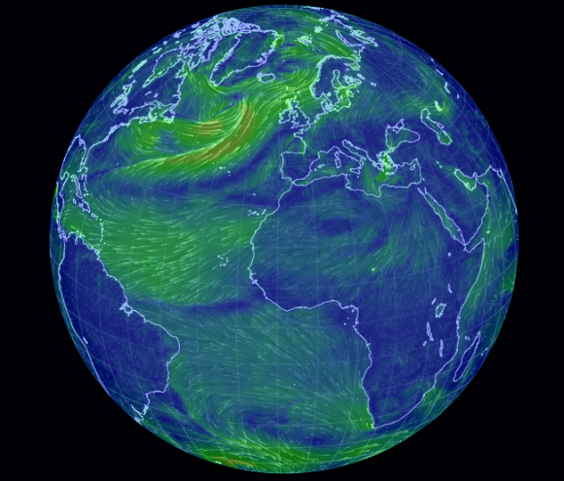

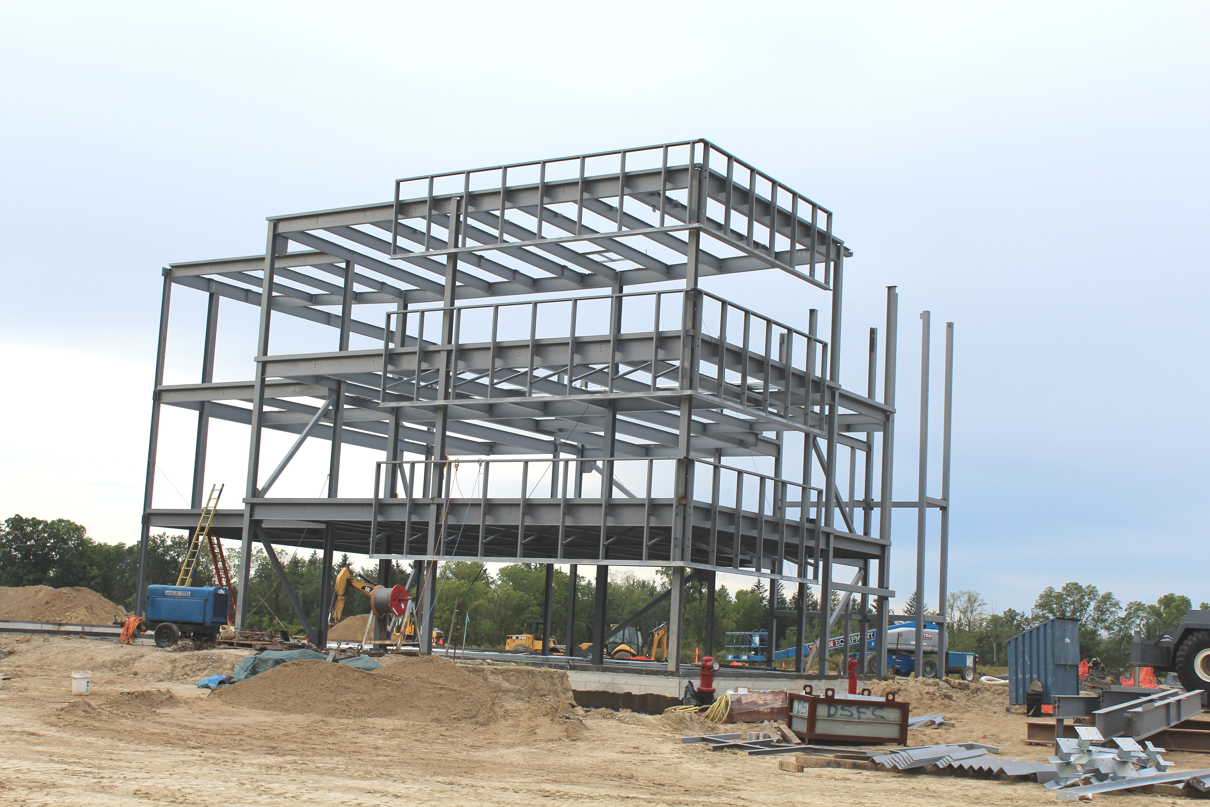

Applications and use Cases
1).Weather Stations:
Home weather stations for enthusiasts.
Professional weather stations for meteorological data collection.
2).Agriculture:
Monitoring wind conditions for spraying pesticides and fertilizers.
Assessing wind patterns to protect crops from wind damage.
3).Renewable Energy:
Site assessment for wind turbine placement.
Monitoring wind speed to optimize turbine performance.
4).Building and Construction:
Ensuring safe working conditions by monitoring wind speed.
Analyzing wind effects on structures.

Slide 12

Applications and use cases
Basic Wind Speed Measurement:
Setting up an anemometer with Arduino to display real-time wind speed on an LCD screen.
Data Logging and Analysis:
Using an SD card module to log wind speed data for analysis over time.
Implementing software to visualize historical wind speed data.
Remote Monitoring:
Sending wind speed data to a remote server using GSM or Wi-Fi modules for remote monitoring.
Integrating with IoT platforms to access data from anywhere
Automated Systems:
Controlling devices based on wind speed, such as automatically adjusting shutters or awnings.
Triggering alarms or notifications when wind speeds exceed safe levels.

Slide 13
RESULT :
SL NO. | VOLTAGE(V) | SPEED(m/s)
1
2
3

Slide 14
CONCLUSION:
Accuracy: The system demonstrated a high degree of accuracy in measuring wind speeds, consistent with the specifications of the anemometer used. Calibration and testing confirmed that the measurements were reliable and aligned with known wind speed standards.
Functionality: The Arduino code was able to process the data from the anemometer and convert it into meaningful wind speed readings. The system was able to handle various wind conditions, providing stable and precise outputs.
Usability: The user interface, whether through an LCD or serial output, was intuitive and provided clear readings. The simplicity of the Arduino setup allowed for easy troubleshooting and modifications.
Limitations: Potential limitations included the sensitivity of the anemometer to extremely high or low wind speeds and the need for periodic calibration to ensure continued accuracy.
Future Enhancements: Possible improvements could involve incorporating wireless data transmission for remote monitoring, adding data logging capabilities, or integrating additional sensors for a more comprehensive weather station.

